Slide 1

SQL PORTFOLIO Project
Domino Pizza Sales
Prepared by Haris Fayyaz
5 June, 2024

Slide 2
Introduction
In this project, I will demonstrate my SQL skills by analyzing a pizza delivery dataset composed of four CSV files: pizzas, pizza types, orders, and order details. This dataset provides detailed information on various pizzas, their types, pricing, and order specifics. Through this analysis, I will extract key business insights, such as popular pizza choices, order trends, and revenue calculations. This project highlights my ability to handle real-world data, perform complex SQL queries, and derive actionable insights.

Slide 3

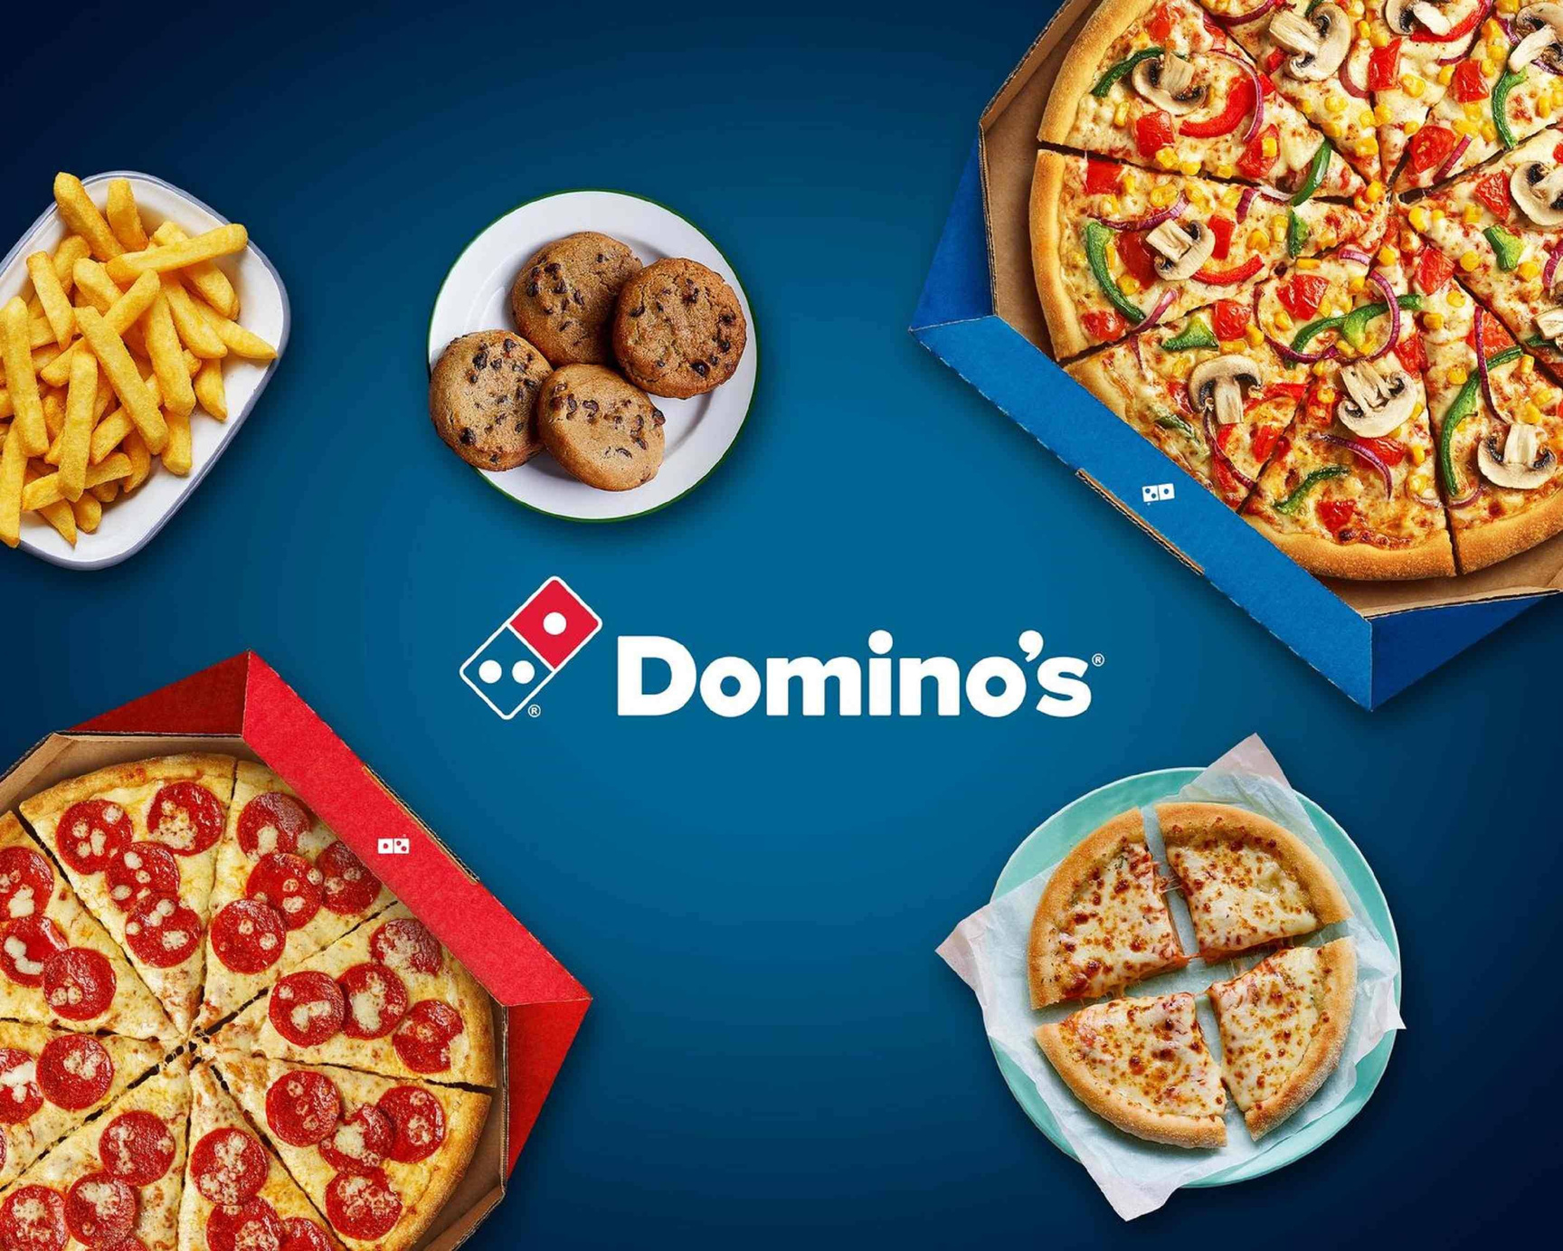
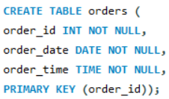
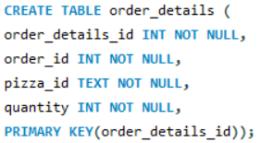
Creating a Schema..

Slide 4
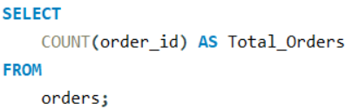

Retrieve the total number of orders placed?
From the above we can observe that the total orders placed amounted to 21,350

Slide 5
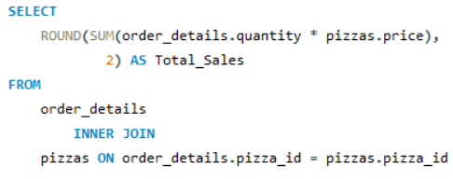

Calculate the total revenue generated from pizza sales?
From the above we can observe that the total revenue generated amounted to 817,860.

Slide 6
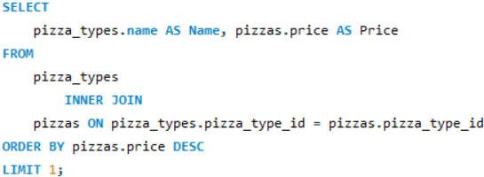

Identify the highest priced pizza?
From the above we can observe that the highest priced pizza is their ‘Greek Pizza’, priced at an amount of 35.95/pizza.

Slide 7
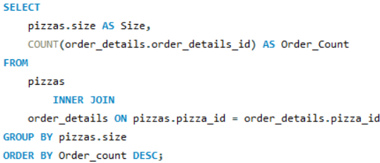
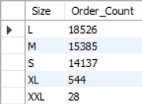
Identify the most common pizza size ordered?
From the above we can observe that the most common pizza from Dominoes is their large pizza followed by their medium pizza, then their small, followed by their extra large, and concluding to their extra extra large pizza.

Slide 8
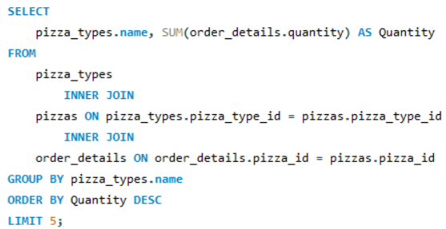
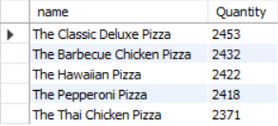
List the top 5 most ordered pizza types along with their quantities?
From the above we can observe that the most ordered pizza type is their ‘Classic Deluxe’, followed by their ‘Barbecue Pizza’, then their ‘Hawaiiian Pizza’, then their ‘Pepperoni Pizza’ concluding to their ‘Thai Chicken Pizza’.

Slide 9
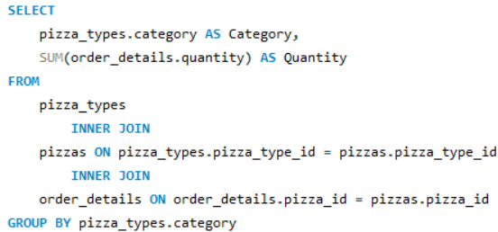
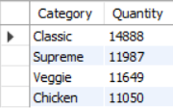
Join the necessary tables to find the total quantity of each pizza category ordered?
From the above we can observe that the most category observed was their ‘Classic’,then ‘Supreme’,then ‘Veggie’ and lastly ‘Chicken’.

Slide 10
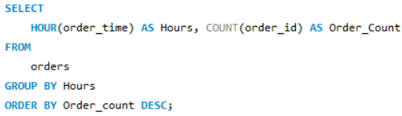
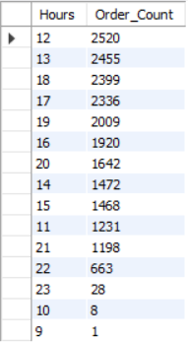
Determine the distribution of orders by hour of the day?
From the above we can observe that the most orders that were placed with in Dominoes was in the evening after 12 pm, till 11 pm at night. However the least orders are to be observed in the morning around 9-10 am.

Slide 11
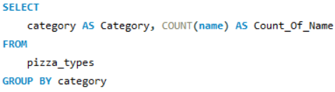
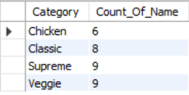
Join relevant tables to find the category-wise distribution of pizzas?
From the above we can observe that the least category could be observed within Chicken, followed by ‘Classic’, then the most number to be within ‘Supreme’ and the ‘Veggie’.

Slide 12
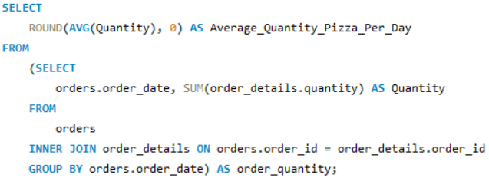

Group the orders by date and calculate the average number of pizzas ordered per day?
From the above we can observe that 138 pizzas were ordered on an average every day.

Slide 13
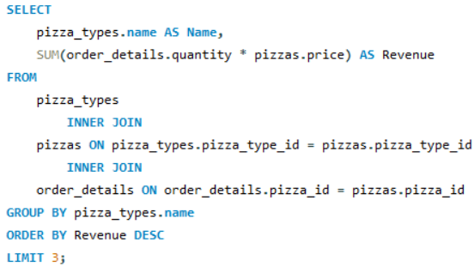

Determine the top 3 most ordered pizza types based on revenue?
From the above we can observe that based on revenues the most ordered pizza was their ‘Thai Chicken’, followed by their ‘Barbecue Chicken’ and lastly their ‘California Chicken Pizza’.

Slide 14
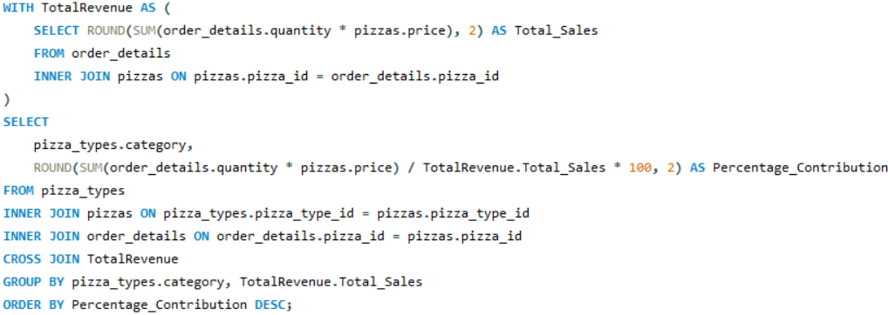
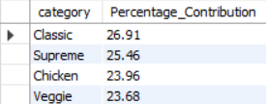
Calculate the percentage contribution of each pizza type to total revenue?
From the above we can observe that based on each pizza type to total revenue , ‘Classic’ had the most percentage share amounting to 26.91%, followed by their ‘Supreme’ category amounting to 25.46%, then their ‘Chicken’ category amounting to 23.96% , and lastly their ‘Veggie’ category amounting to 23.68%.

Slide 15
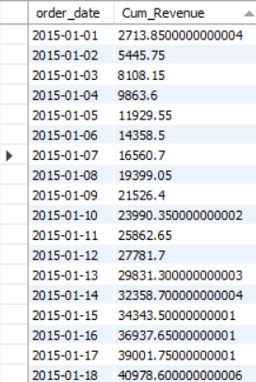
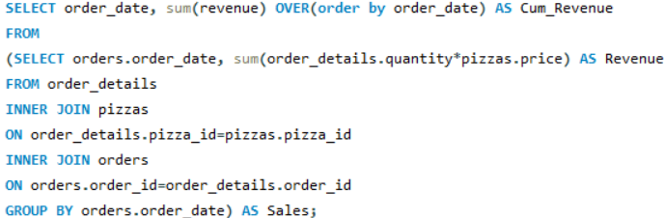
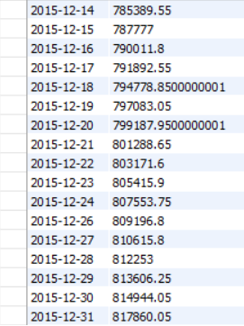
Analyze the cumulative revenue generated over time?
From the above we can observe that the cummulative revenues for Dominoes, summing to around 817,860 at the end.

Slide 16
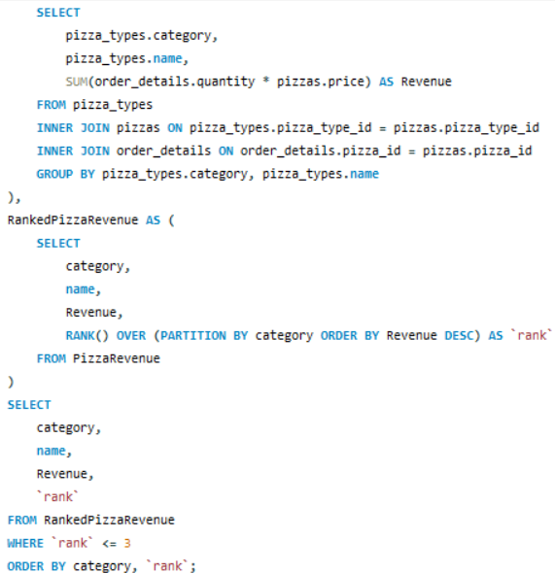
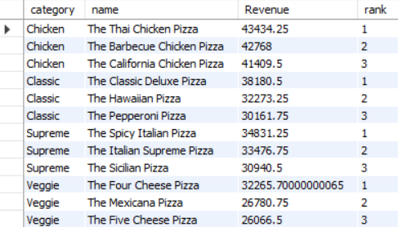
Determine the top 3 most ordered pizza types based on revenue for each pizza category?
From the above category we observe the ‘Thai Chicken Pizza’ to be the most ordered based on chicken category, ‘Classic Deluxe Pizza’ ordered the most in classic category ,’’Spicy Italian ordered the most in supreme category and lastly the ‘Four Cheese’ pizza orderd in the veggie category.

Slide 17
Conclusion
This project delves into the power of data analysis within Domino's Pizza operations, revealing critical insights: a total revenue of $817,860 from 21,350 orders, with the highest-priced item being the ‘Greek Pizza’ at $35.95. Large pizzas emerged as the most popular size, while the ‘Classic Deluxe’ pizza led sales. Peak ordering times were between 12 PM and 11 PM, with an average of 138 pizzas ordered daily. Revenue was notably driven by pizzas like ‘Thai Chicken’, ‘Barbecue Chicken’, and ‘California Chicken’. These findings guide strategic decisions in product offerings, pricing, and marketing to enhance customer satisfaction and fuel business growth.

Slide 18
Thank you

